Slide 1
n8n
AI AGENTS & AUTOMATION
AUTOMATION
AI-Powered Financial
Process Automation
using n8n
Fraud Detection Workflow — Real-Time Transaction Risk Scoring
GROUP MEMBERS
Khushi Lathwal | Rohit | Kunal | Divanshu | Kanav
MBA Applied Finance — Chitkara University

Slide 2
SLIDE 02
Problem Statement
THE PROBLEM
WHY AUTOMATE IN 2026?
Mid-sized NBFCs and banks process hundreds of thousands of UPI/NEFT/IMPS transactions daily.
₹20L Cr+
Monthly UPI volume
⏱
Fraud detected 24+ hrs later — money already gone
24 Hrs
👤
Manual analyst review misses patterns at high volume
Avg manual fraud detection time
🚨
No real-time alerts — risk team notified end of day
~0.1%
📋
No structured audit trail from manual review
Fraud rate on digital txns
📈
UPI volume crossed ₹20L crore/month — unscalable
<1 Sec
n8n rule engine decision time

Slide 3
SLIDE 03
Existing Manual Workflow
🏦
📥
👁
📞
⛔
Transaction Occurs
Raw Data Export
Manual Review
Manual Escalation
Action Taken
▶
▶
▶
▶
UPI/NEFT/IMPS initiated by customer
Transactions exported to Excel daily
Analyst scans rows for anomalies
Phone call to Risk Manager if suspicious
Account flagged — often 24+ hrs later
KEY INEFFICIENCIES
❌ 24+ hour delay ❌ Human error prone ❌ No real-time alerts ❌ No audit trail ❌ Not scalable

Slide 4
SLIDE 04
Dataset Design
Self-created dataset — 55 transactions, 13 input columns + 3 n8n output columns
Transaction_ID
Prev_Txn_Count
Unique transaction identifier
Previous transaction history
Customer_ID
Outflow_Ratio_%
Unique customer identifier
% of money immediately transferred out
Customer_Name
Transaction_Type
Customer full name
UPI / NEFT / IMPS / Wire
Amount_(INR)
Merchant_Category
Transaction amount in rupees
Electronics, Food, Crypto etc.
Transaction_Time
Device_Status
Date and time of transaction
Known / New device
Location
Impossible_Travel
City / Foreign / Unknown
Yes / No flag
Account_Age_(Days)
Days since account opened
n8n OUTPUT COLUMNS (filled by automation): Rules_Triggered | Risk_Score | Fraud_Status

Slide 5
SLIDE 05
Proposed n8n Automation Approach
12 FRAUD DETECTION RULES
CUMULATIVE SCORING
R1
Amount > ₹50,000
0
CLEAR
Auto Approve
R2
Round Amount (₹10K/₹50K/₹1L)
1
LOW RISK
Log & Monitor
R3
Micro Probe < ₹10 (new account)
2–3
MEDIUM RISK
Alert Email
R4
Velocity Breach — repeat customer
R5
Mule Pattern — outflow > 90%
4+
HIGH RISK
Block + Escalate
R6
Off Hours (1AM–4AM)
TRIGGER & OUTPUT
R7
Dormant Account Spike
🔁 Trigger: New row added in Google Sheets
R8
First Txn High Value > ₹40K
⚙️ Process: Code node checks all 12 rules
R9
Unknown / Foreign Location
🔀 Route: IF nodes route to 4 branches
R11
UPI Abuse > ₹5,000
📊 Update: Sheet gets Rules + Score + Status
R12
Cross-Border Micro Split
📧 Alert: Gmail sent for Medium & High Risk

Slide 6
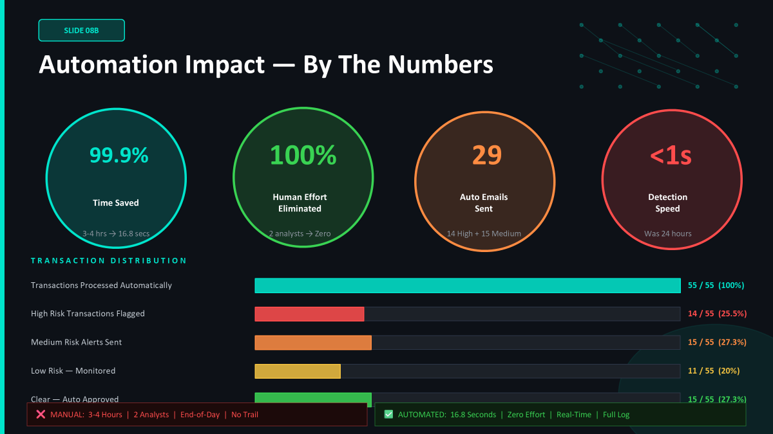

Slide 7
SLIDE 06
n8n Workflow Architecture
HIGH RISK
Sheet Update
+ Gmail Alert 🚨
MEDIUM RISK
Sheet + Gmail ⚠️
TRIGGER
GET ROWS
CODE NODE
IF NODE 1
IF NODE 2
Execute
Workflow
▶
Score ≥ 2?
Medium Risk
Google
Sheets Read
▶
12 Rules +
Risk Score
▶
Score ≥ 4?
High Risk
▶
LOW RISK
IF NODE 3
Sheet Update Only
▶
Score = 1?
Low Risk
CLEAR
▶
Auto Approve ✅
RESULT: 55 Transactions → 14 HIGH RISK | 15 MEDIUM RISK | 11 LOW RISK | 15 CLEAR — Completed in 16.8 seconds

Slide 8
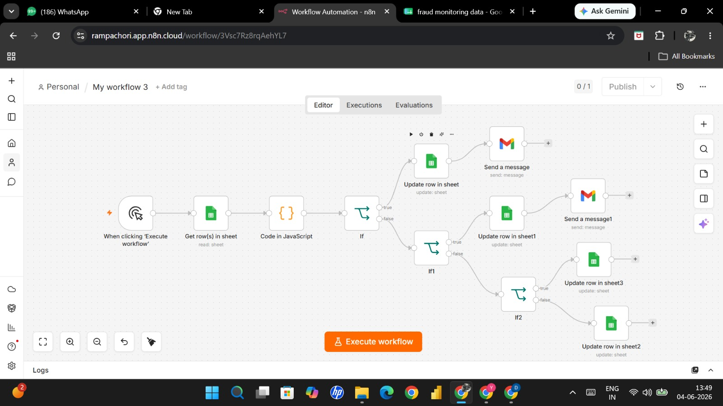

Slide 9
SLIDE 07
Workflow Demonstration
Live execution evidence — n8n processed 55 transactions in 16.834 seconds
✅
🚨
⚠️
📊
n8n Execution Log
HIGH RISK Email
MEDIUM RISK Email
Google Sheet Updated
Succeeded in 16.834s
ID#70 | All nodes green
55 items processed
TXN015 — Score: 5
Rules: R1, R6, R7, R8, R9
Action: Block + Escalate
TXN030 — Score: 2
Rules: R1, R6
Action: Review & Monitor
All 55 rows filled:
Rules_Triggered
Risk_Score + Fraud_Status
SAMPLE EMAIL:
Subject: 🚨 HIGH RISK ALERT – TXN001 | Customer: Rahul Sharma | Amount: ₹75,000 | Location: Foreign | Rules: R1:HighValue, R4:Velocity, R6:OffHours, R9:ForeignLoc | Score: 5

Slide 10
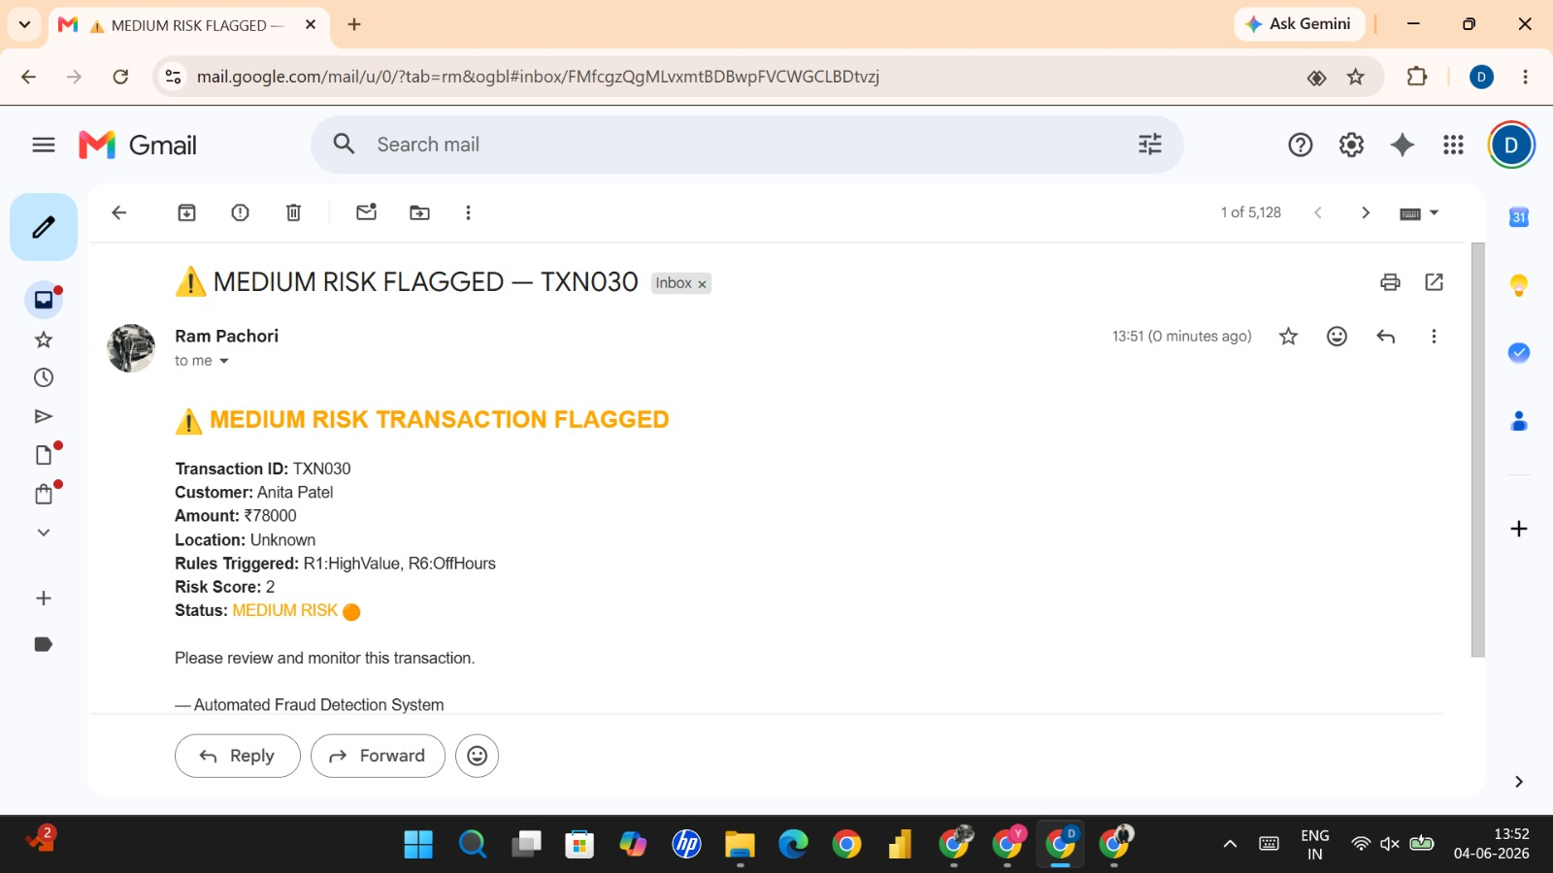

Slide 11
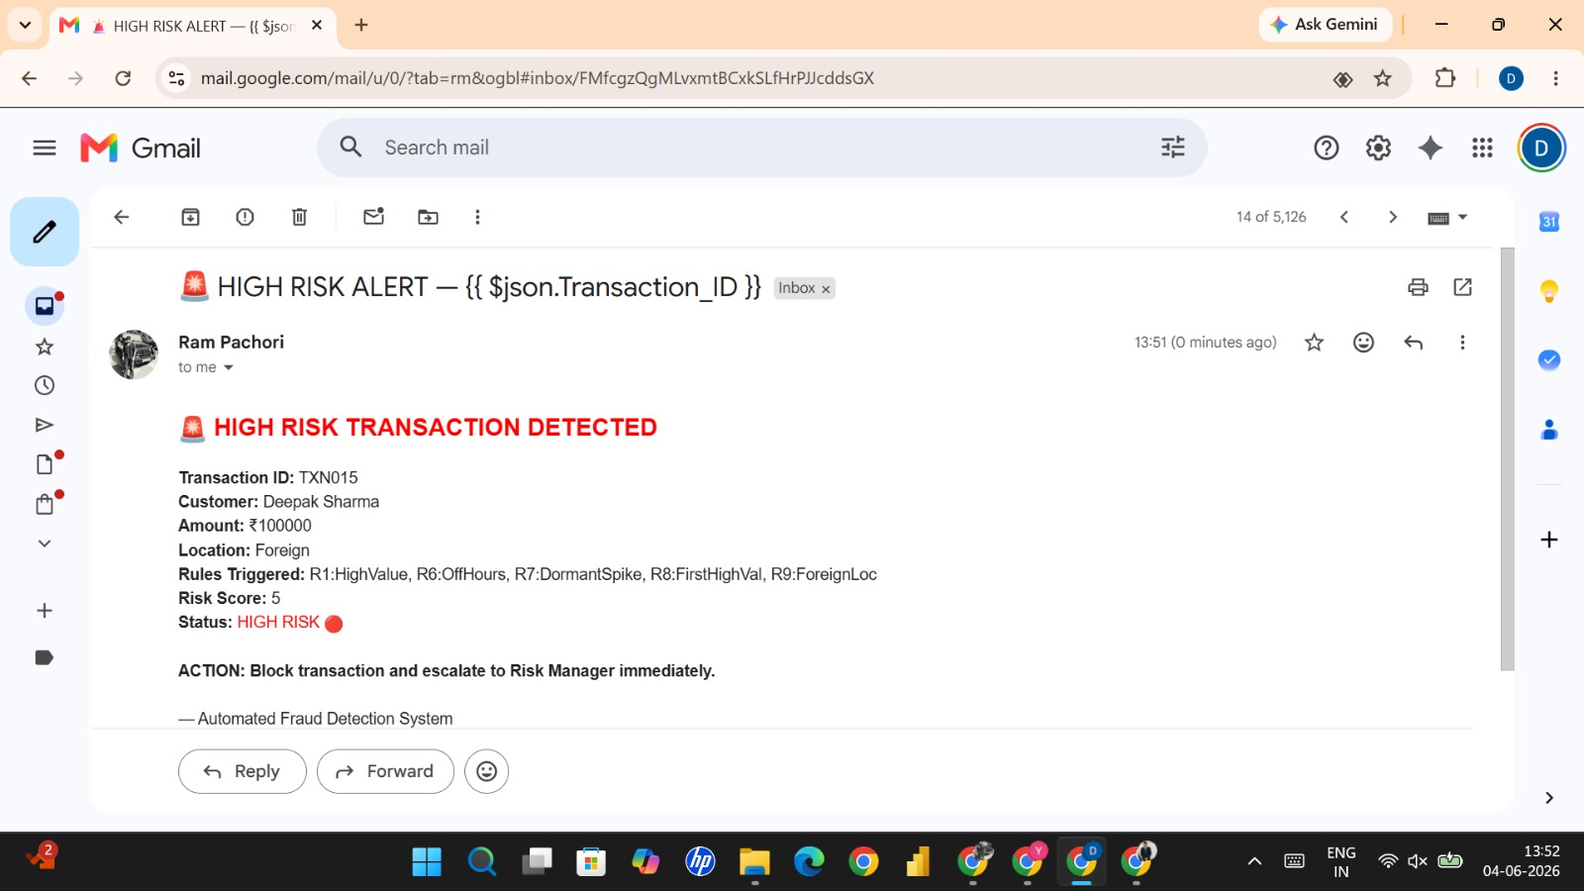

Slide 12
SLIDE 08
Business Impact Analysis
Parameter | Manual Process | Automated (n8n)
Time for 55 Transactions | ~3–4 Hours | 16.8 Seconds
Human Effort Required | 1–2 Analysts | Zero
Fraud Detection Speed | End of Day (24 hrs) | Real-Time (<1 sec)
Error Rate | High (manual fatigue) | Near Zero
Alert Mechanism | Phone call / Email (manual) | Automated Gmail alert
Audit Trail | Informal / inconsistent | Structured Google Sheet log
Scalability | Limited to analyst capacity | Unlimited — auto-scales
99.9%
100%
24hrs → <1s
29 Emails
Time Saved
Human Effort Reduced
Detection Speed
Auto-Sent (Medium+High)

Slide 13
SLIDE 09
Challenges & Limitations
🌐 Internet Dependency
📊 Data Quality Concerns
n8n requires active internet connectivity. Any network outage halts the workflow completely — no offline fallback exists.
Incorrect or incomplete input data (empty fields, wrong formats) can cause rule misfire or silent scoring errors.
🔢 Rule-Based Limitations
⚡ Velocity Rule Simplification
Static rules cannot learn from new fraud patterns. Sophisticated fraudsters who know the thresholds can bypass detection.
True velocity check needs transaction history lookup. Our implementation uses a pre-flagged column as a proxy.
📈 Scalability at Real Scale
🔒 Security & Compliance
n8n cloud has execution limits. Processing millions of real bank transactions would require enterprise infrastructure.
Sensitive financial data passing through n8n and Gmail raises GDPR/RBI data localisation compliance questions.

Slide 14
SLIDE 10
Future Scope
🤖
🔮
💬
ML Integration
Predictive Scoring
WhatsApp Alerts
Replace static rules with a trained machine learning model — Random Forest or XGBoost — that learns evolving fraud patterns from historical data.
Predict fraud probability before a transaction completes using customer behavioural profiles and real-time velocity analysis.
Add Twilio or WhatsApp Business API node in n8n to send instant push notifications to customers and risk managers.
🏦
📱
🌍
Core Banking Integration
Dashboard & Analytics
FEMA & RBI Compliance
Connect directly to CBS (Core Banking System) via API to auto-block accounts in real time without manual intervention.
Build a live Looker Studio / Power BI dashboard connected to the Google Sheet for real-time fraud trend visualisation.
Add automated RBI STR (Suspicious Transaction Report) filing and FEMA cross-border monitoring with regulatory alerts.

Slide 15
SLIDE 11
Learning Outcomes
01
Business Process Automation
02
Fraud Detection Logic
Understood how manual financial workflows can be mapped, analysed for inefficiencies, and redesigned using automation tools like n8n.
Learned how real-world banks (HDFC, Razorpay, Stripe) implement rule-based fraud scoring and applied the same principles in a working system.
03
n8n Workflow Design
04
JavaScript for Finance
Built a multi-node workflow with Trigger, Code, IF/Condition, Google Sheets, and Gmail nodes — gaining practical low-code development experience.
Wrote real JavaScript code to process financial data, apply conditional rules, compute cumulative scores, and return structured outputs.
05
Data Design & Modelling
06
Business Impact Analysis
Designed a business-relevant 55-row dataset with 13 input columns specifically structured to trigger all 12 fraud rules meaningfully.
Quantified automation value — 99.9% time reduction, zero human effort, real-time detection — using structured before/after comparison.

Slide 16
SLIDE 12
Conclusion
"What once took a team of analysts 3–4 hours to review manually — our n8n workflow completes in 16.8 seconds with zero human effort and real-time email alerts."
✅
Successfully automated fraud detection for 55 transactions using 12 real-world rules
📊
Google Sheet updated in real-time with Rules_Triggered, Risk_Score, and Fraud_Status
📧
29 automated alert emails sent — 14 HIGH RISK escalations + 15 MEDIUM RISK flags
🏦
Workflow mirrors real systems used by Razorpay, HDFC Bank, Stripe Radar, and Visa
🚀
n8n proves that intelligent automation is accessible, scalable, and business-ready in 2026

